Slide 1
GREEDY ALGORITHM
PRESENTER: SRESTHA SADHU

Slide 2
Spanning tree & MINIMUM SPANNING TREE
Spanning tree means all vertices must be connected.
So the two disjoint subsets of vertices must be connected to make a Spanning Tree.
And they must be connected with the minimum weight edge to make it a Minimum Spanning Tree.

Slide 3
Prim’s Algorithm
Prim’s Algorithm is a famous greedy algorithm.
It is used for finding the Minimum Spanning Tree (MST) of a given graph.
To apply Prim’s algorithm, the graph must be weighted, connected and undirected.

Slide 4
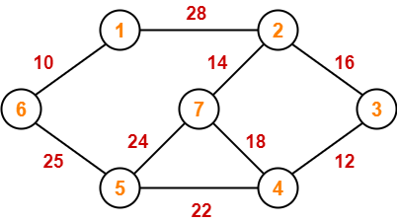
PRACTICE PROBLEMS BASED ON PRIM’S ALGORITHM

Slide 5
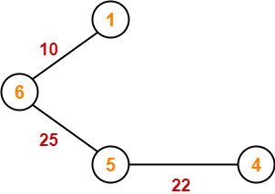
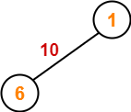
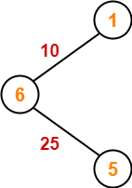
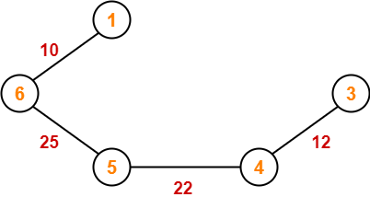
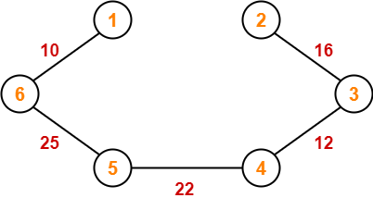
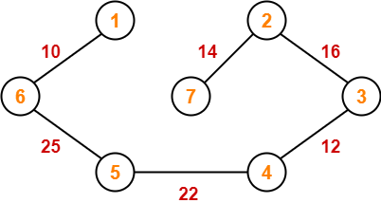
Solution
Step-01: Step-02: Step-03:
Step-04: Step-05: Step-06:

Slide 6
Since all the vertices have been included in the MST, so we stop.
Now, Cost of Minimum Spanning Tree
= Sum of all edge weights
= 10 + 25 + 22 + 12 + 16 + 14
= 99 units

Slide 7
ALGORITHM
MST-PRIM(G, w, r)
1 for each u ∈ G.V
2 u.key ← ∞
3 u.π ← NIL
4 r.key ← 0
5 Q ← G.V
6 while Q ≠ Ø
7 u ← EXTRACT-MIN(Q)
8 for each v ∈ G.Adjacent[u]
9 if v ∈ Q and w(u, v) < v.key
10 v.π ← u
11 v.key ← w(u, v)

Slide 8
Complexity
The time complexity required for one call to EXTRACT-MIN(Q) is O(log V).
The while loop at line 6 is executing total V times.
so EXTRACT-MIN(Q) is called V times. So the complexity of EXTRACT-MIN(Q) is O(V logV).
The for loop at line 8 is executing total 2E times as length of each adjacency lists is 2E for an undirected graph.
The time required to execute line 11 is O(log v) by using the DECREASE_KEY operation on the min heap.
Line 11 also executes total 2E times. So the total time required to execute line 11 is O(2E logV) = O(E logV).
The for loop at line 1 will be executed V times. Using the procedure to perform lines 1 to 5 will require a complexity of O(V).

Slide 9
Total time complexity of MST-PRIM is the sum of the time complexity required to execute steps 1 through 3 for a total of O(VlogV + (E logV + V) = O(E logV)

Slide 10
HUFFMAN CODING
Used for lossless compression of data
Uses variable length encoding
Assigns variable length code to all the characters
The character which occurs least frequently gets the largest code

Slide 11
EXAMPLE
CHARACTERS | FREQUENCIES
a | 10
e | 15
i | 12
o | 3
u | 4
s | 13
t | 1

Slide 12
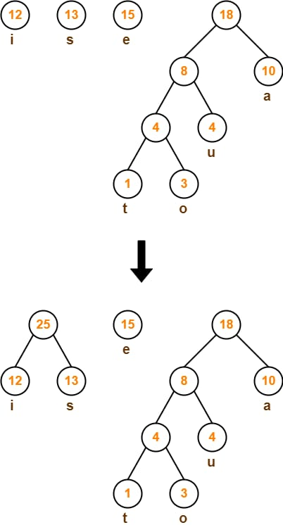

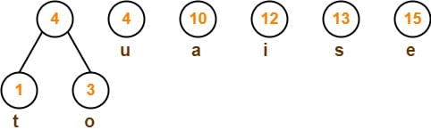
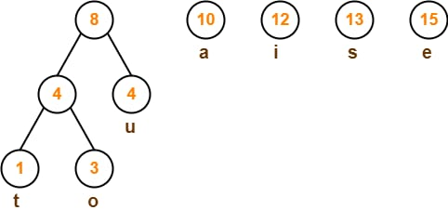
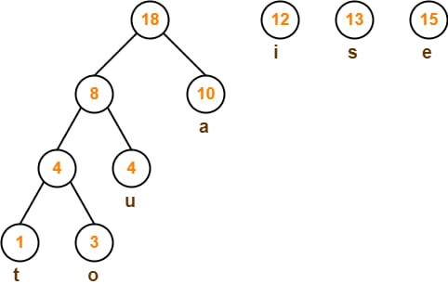
solution

Slide 13
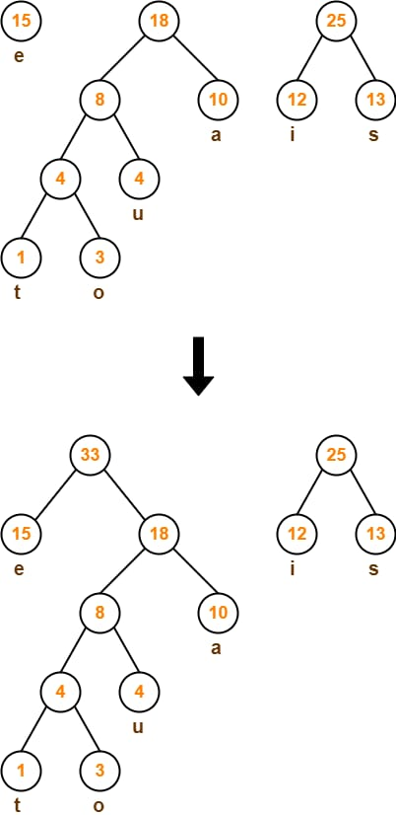
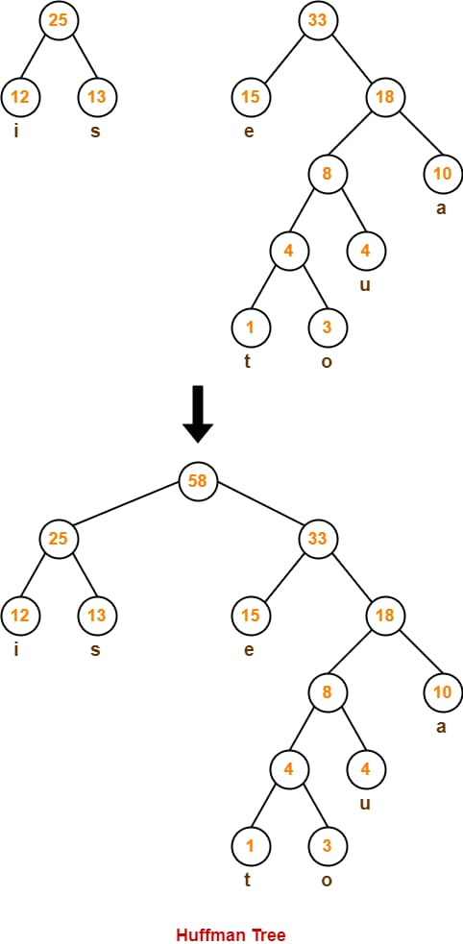

Slide 14
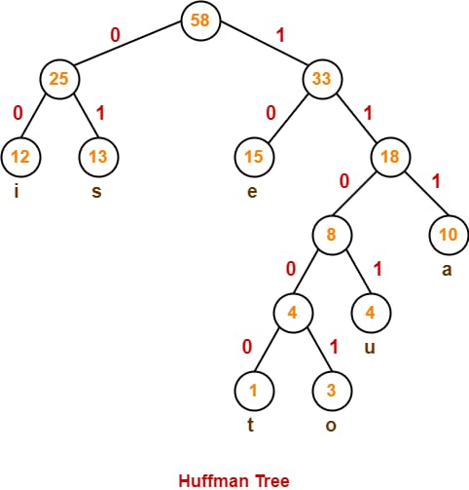

Slide 15
Huffman Code For Characters:
a= 111 e = 10 i = 00 o = 11001 u = 1101 s = 01 t = 11000
From here, we can observe-Characters occurring less frequently in the text are assigned the larger code. Characters occurring more frequently in the text are assigned the smaller code.
Average Code Length:
we have-Average code length=
∑ ( frequencyi x code lengthi ) / ∑ ( frequencyi )
= { (10 x 3) + (15 x 2) + (12 x 2) + (3 x 5) + (4 x 4) + (13 x 2) + (1 x 5) } / (10 + 15 + 12 + 3 + 4 + 13 + 1)
= 2.52
Length of Huffman Encoded Message
Total number of bits in Huffman encoded message= Total number of characters in the message x Average code length per character
= 58 x 2.52
= 146.16
≅ 147 bits

Slide 16
ALGORITHM
Step-01: Create a leaf node for each character of the text. Leaf node of a character contains the occurring frequency of that character.
Step-02: Arrange all the nodes in increasing order of their frequency value.
Step-03: Considering the first two nodes having minimum frequency
Step-04: Keep repeating Step-02 and Step-03 until all the nodes form a single tree. The tree finally obtained is the desired Huffman Tree.

Slide 17
time Complexity
The time complexity analysis of Huffman Coding is as follows-
extractMin( ) is called 2 x (n-1) times if there are n nodes.
As extractMin( ) calls minHeapify( ), it takes O(logn) time.
Thus, Overall time complexity of Huffman Coding becomes O(nlogn).
Here, n is the number of unique characters in the given text.

Slide 18
THANK YOU

